Slide 1
Algorithms
Recurrence Relation

Slide 2
Recurrence Relations (1/2)
A recurrence relation is an equation which is defined in terms of itself.
Why are recurrences good things?
  Many natural functions are easily expressed as recurrences:

Slide 3
Recurrence Relations (2/2)
we have general and boundary conditions, with the general condition breaking the problem into smaller and smaller pieces.
The initial or boundary condition terminate the recursion.

Slide 4
Methods for Solving Recurrences
Iteration method
Substitution method
Recursion Tree
Master method
4

Slide 5
Iteration Method
Expand the recurrence
Work some algebra to express as a summation
Evaluate the summation

Slide 6
The Iteration Method
T(n) = c + T(n/2) and T(1)=base case
T(n) = c + T(n/2)
= c + c + T(n/4)
= c + c + c + T(n/8)
= c + c + c +...............+ T(n/2^{k})
Assume, n/2^{k} =1 [base case]
n = 2^{k}
T(n) = c + c + … + c + T(1) =kc+T(1)
= clgn + T(1)
= o(lgn)
T(n/2) = c + T(n/4)
T(n/4) = c + T(n/8)
k=lgn
k times
6

Slide 7
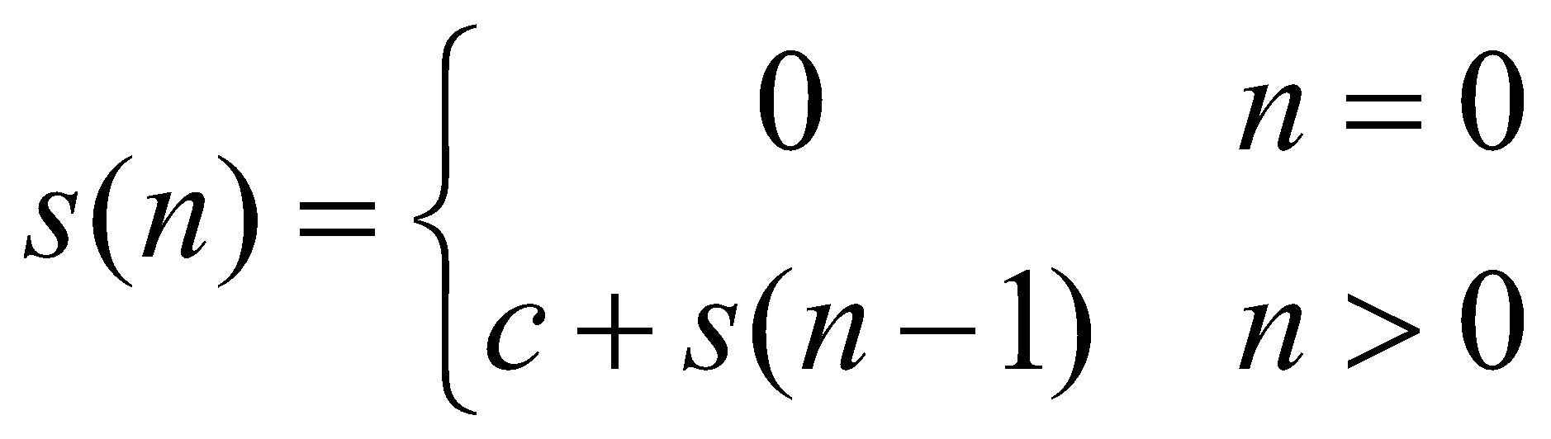
The Iteration Method
s(n) = c + s(n-1)
=c + c + s(n-2)
=2c + s(n-2)
=2c + c + s(n-3)
=3c + s(n-3)
…
=kc + s(n-k)
= ck + s(n-k)
Assume s(n-k)=s(0)[base case]
n-k=0
n=k
Then,
s(n) = ck + s(n-k)
=cn+s(n-n)
=cn+s(0)
=cn
= O(n)

Slide 8
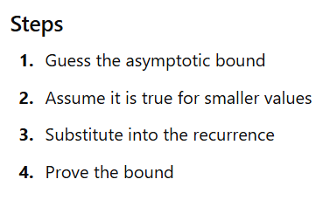
The substitution method
Guess the solution first, then prove it using mathematical induction.
8

Slide 9

The substitution method
Example: T(n)=2T(n/2)+n
Assume, T(n)=O(nlog⁡n)
⇒T(n)≦ c.nlog⁡n for a positive constant C and for all n>
Assume that it is true for all m<n.
we can say that, T(n/2)=O(n/2log⁡n/2) as n/2<n
⇒T(n/2)≦ c.n/2log⁡n/2
9

Slide 10
The substitution method
Example: T(n)=2T(n/2)+n
Now, T(n)=2T(n/2)+n
≦2*c.n/2log⁡n/2 +n
=cnlogn/2+n
=cn(logn-log2)+n
=cnlogn-cnlog2+n
T(n)≦cnlogn [proved]
10

Slide 11
Another Example
T(n) = c + T(n/2)
Guess: T(n) = O(lgn)
  Induction goal: T(n) ≤ c lgn, c and n ≥ n₀
11

Slide 12
Example 2
T(n) = T(n-1) + n
Guess: T(n) = O(n²)
  Induction goal: T(n) ≤ c n², for some c and n ≥ n₀
12

Slide 13
Recursion Tree
The recursion tree method solves recurrence relations by:
Expanding recursive calls as a tree
Calculating work done at each level
Summing total work of all levels
Each node represents the cost of a recursive call.

Slide 14
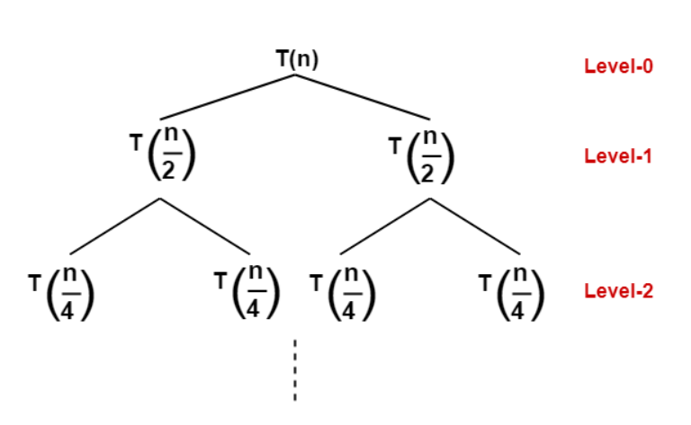
Recursion Tree
Solve the following recurrence relation using recursion tree method-
T(n) = 2T(n/2) + n
Solution- Draw a recursion tree based on the given recurrence relation.
The given recurrence relation shows-
A problem of size n will get divided into 2 sub-problems of size n/2.
Then, each sub-problem of size n/2 will get divided into 2 sub-problems of size n/4 and so on.

Slide 15
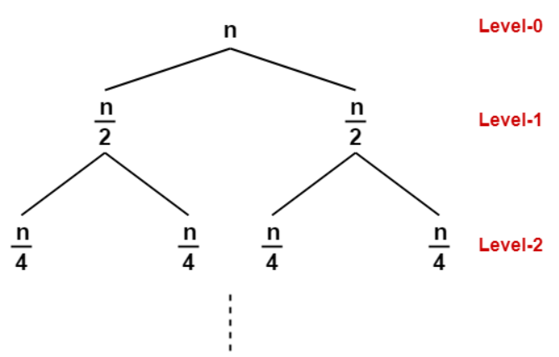
Recursion Tree
The given recurrence relation shows-
The cost of dividing a problem of size n into its 2 sub-problems and then combining its solution is n.
The cost of dividing a problem of size n/2 into its 2 sub-problems and then combining its solution is n/2 and so on
This is illustrated through following recursion tree where each node represents the cost of the corresponding sub-problem-

Slide 16



Recursion Tree
Determine cost of each level-
Cost of level-0 = n
Cost of level-1 = n/2 + n/2 = n
Cost of level-2 = n/4 + n/4 + n/4 + n/4 = n and so on.
Determine total number of levels in the recursion tree-
Size of sub-problem at level-0 =
Size of sub-problem at level-1 =
Size of sub-problem at level-2 =
Size of sub-problem at level-i=

Slide 17
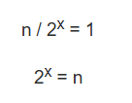



Recursion Tree
Suppose at level-x (last level), size of sub-problem becomes 1. Then-
Total cost=n+n+n+n………[ times]

Slide 18
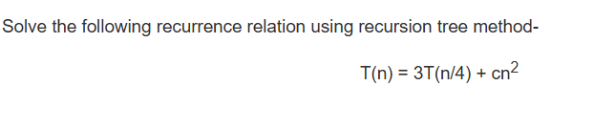
Recursion Tree

Slide 19


Master Method
The Master Method applies to recurrences of the form:
Where:
a≥1= number of recursive calls
b>1 = factor by which input size decreases
f(n)= extra work done outside recursion
=

Slide 20







Master Method
Solution:
Case1: if
Case2: if
  if p>-1 then
  p=-1 then
  P<-1 then
Case3: if
  if p>=0
  p<0 then

Slide 21

Master Method
Examples of case 1:
  T(n)=2T(n/2)+1 as f(n)=1 =
  T(n)=4T(n/2)+n here, k=1 and p=0.
  T(n)=8T(n/2)+n here, k=1 and p=0
  T(n)=8T(n/2)+ here, k=2 and p=0
  T(n)=8T(n/2)+nlogn here k=1 and p=1

Slide 22
Master Method
Examples of case 2:
  T(n)=2T(n/2)+n
  T(n)=4T(n/2)+
  T(n)=4T(n/2)+ logn
  T(n)=2T(n/2)+n/logn

Slide 23
Examples of case 3:
  T(n)=T(n/2) +
  T(n)=T(n/2) + logn

